Slide 1

IPL Data Analysis
Exploring trends and insights from Indian Premier League matches.

Slide 2
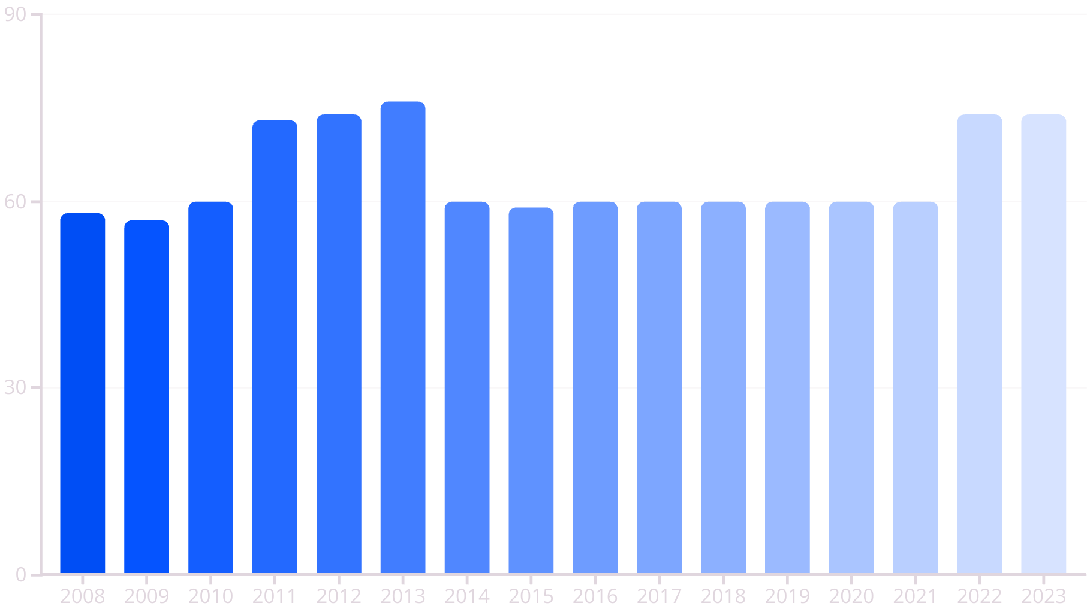
Matches Per Season

Slide 3
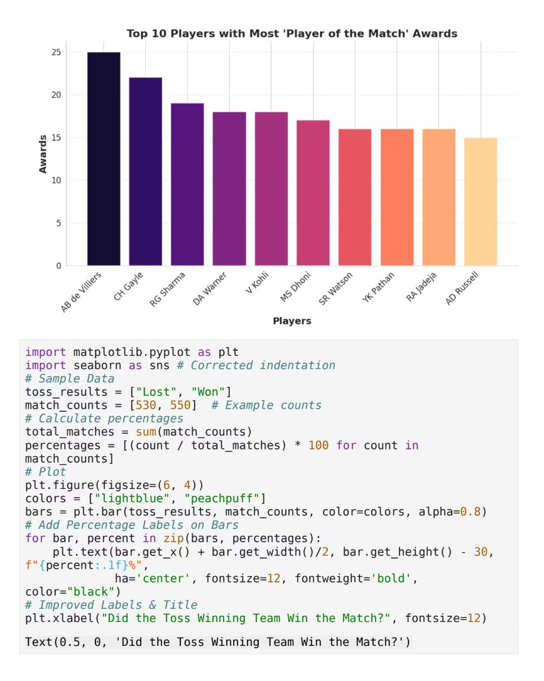
Top Players: Player of the Match Awards
AB de Villiers leads with 25 awards.
CH Gayle follows with 22 awards. Consistent top performers.

Slide 4
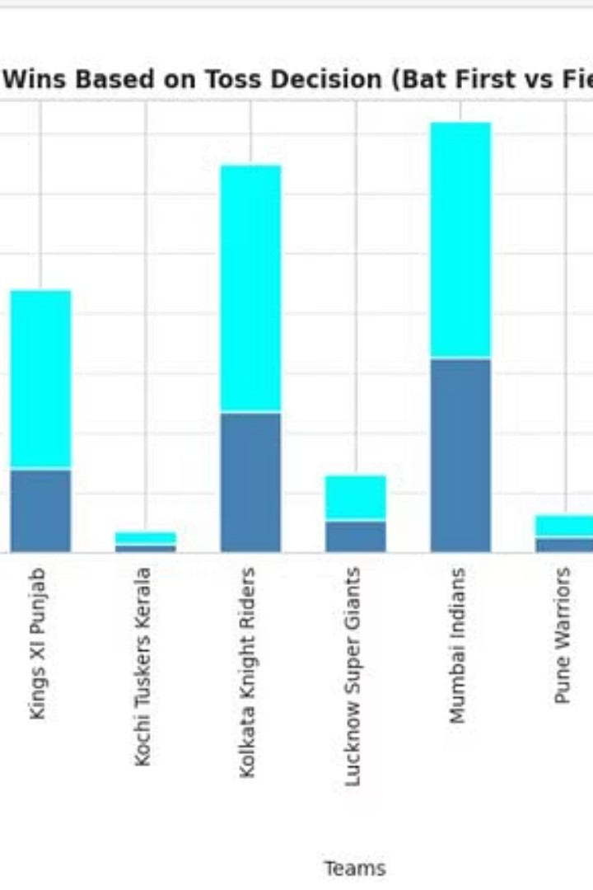

Team Wins by Toss Decision
Bat First Wins
Teams batting first secured wins.
Field First Wins
Teams fielding first also won.
Decision Impact
Toss decision influences game outcome.

Slide 5
IPL Team Performance Over Seasons
Mumbai Indians
Strong performance across seasons.
Chennai Super Kings
Consistent wins over time.
Kolkata Knight Riders
Fluctuating but notable wins.

Slide 6
IPL Team Wins Heatmap
Mumbai Indians
144 total wins.
Chennai Super Kings
138 total wins.
Kolkata Knight Riders
131 total wins.

Slide 7
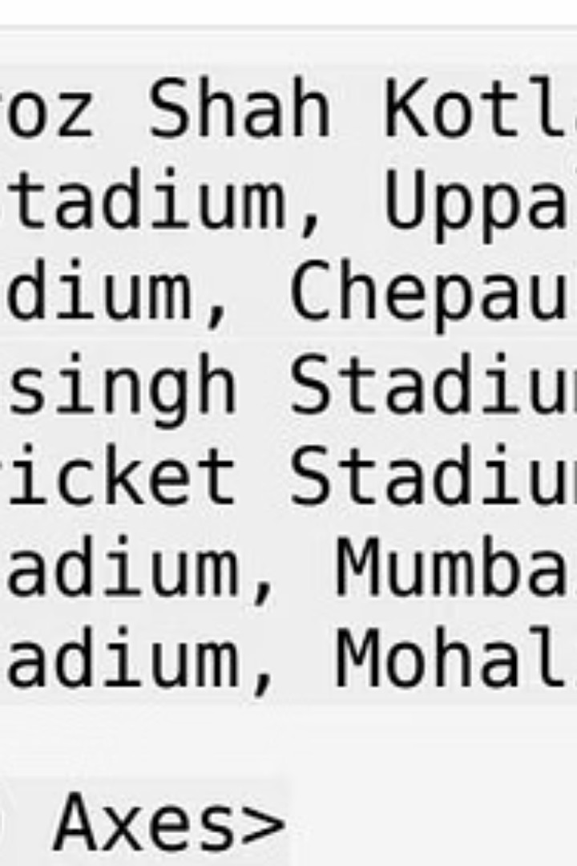
Total IPL Matches by Venue
1
Eden Gardens
77 matches hosted.
2
Wankhede Stadium
73 matches hosted.
3
M Chinnaswamy Stadium
65 matches hosted.

Slide 8
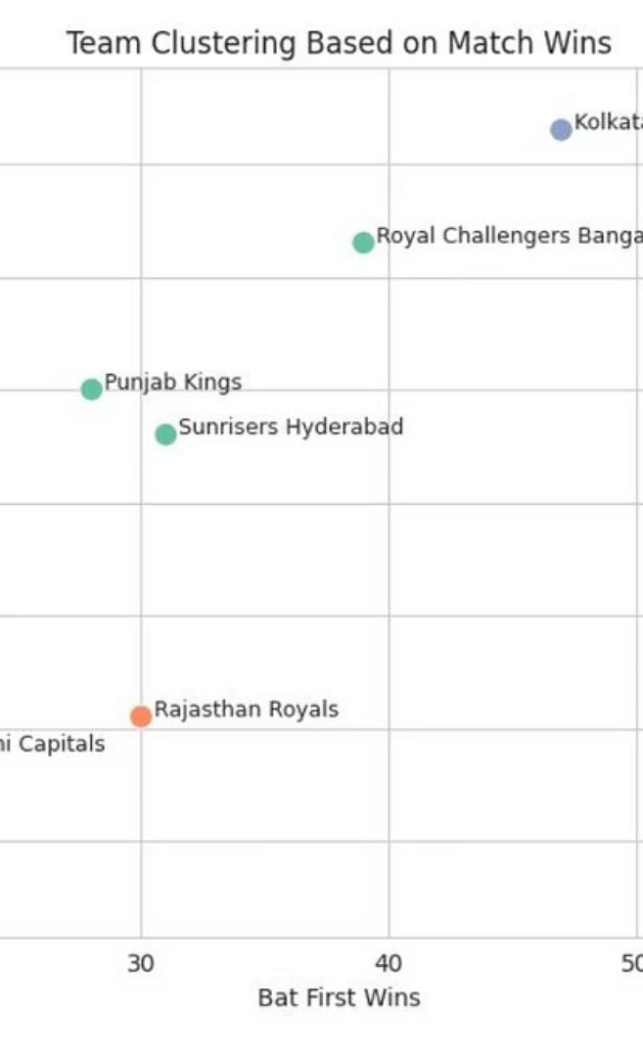



Team Clustering by Wins
High Wins
Teams with many wins.
Moderate Wins
Average performing teams.
Lower Wins
Teams with fewer victories.

